Slide 1
From LLM to RAG to Agent

Slide 2
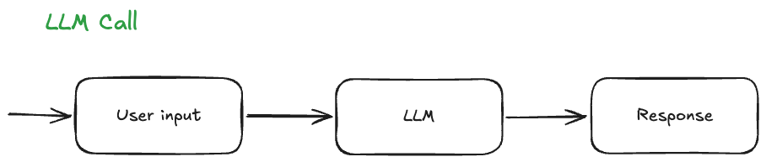

Slide 3
Hi, my name is Trinity
What is my name?
Describe the rabbit
What is 3487643.57 * 933668793.2 % 77243
What day is it today?
Reverse the following text “This text is tricky to reverse”

Slide 4
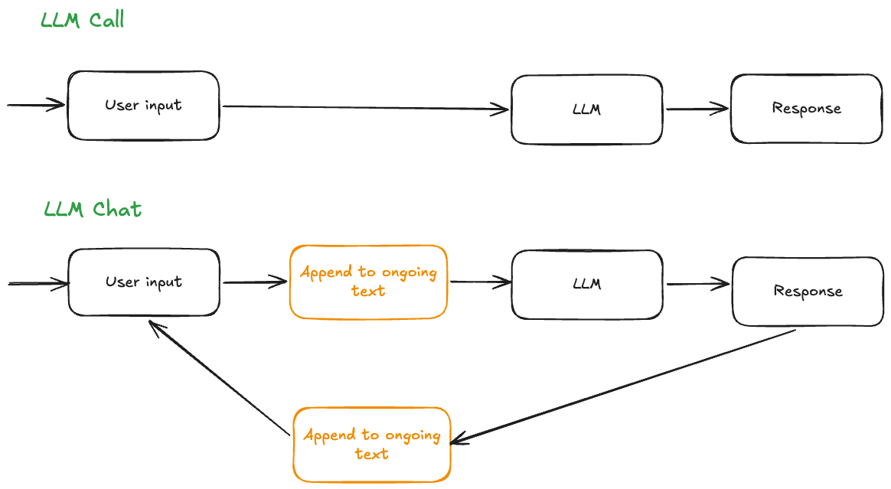

Slide 5
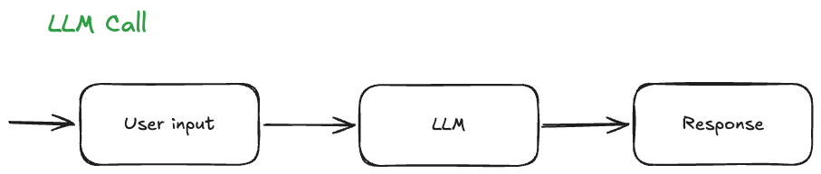

Slide 6
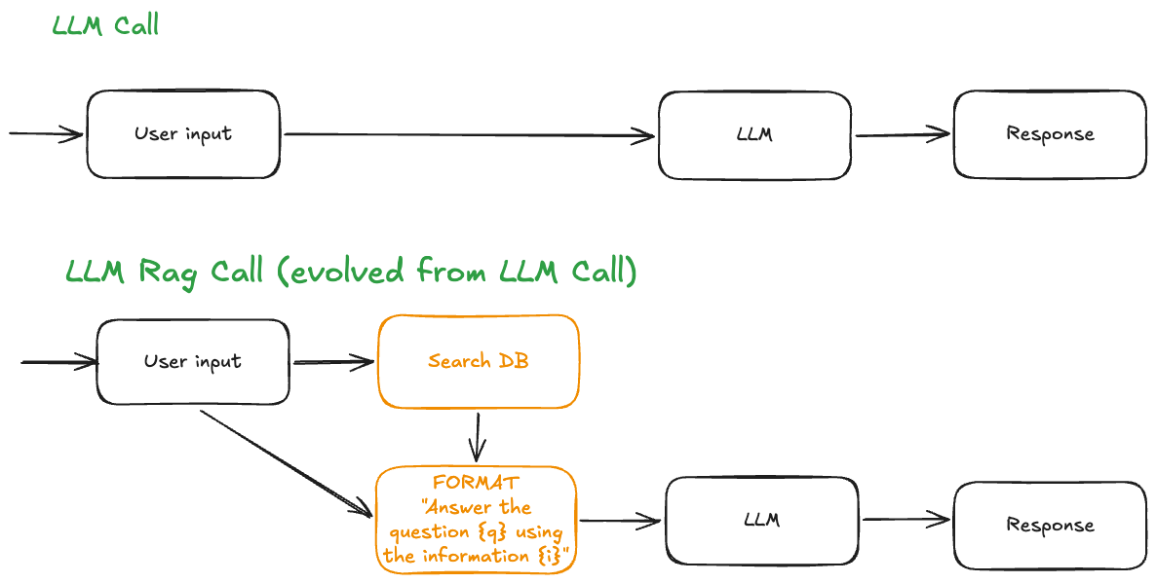

Slide 7
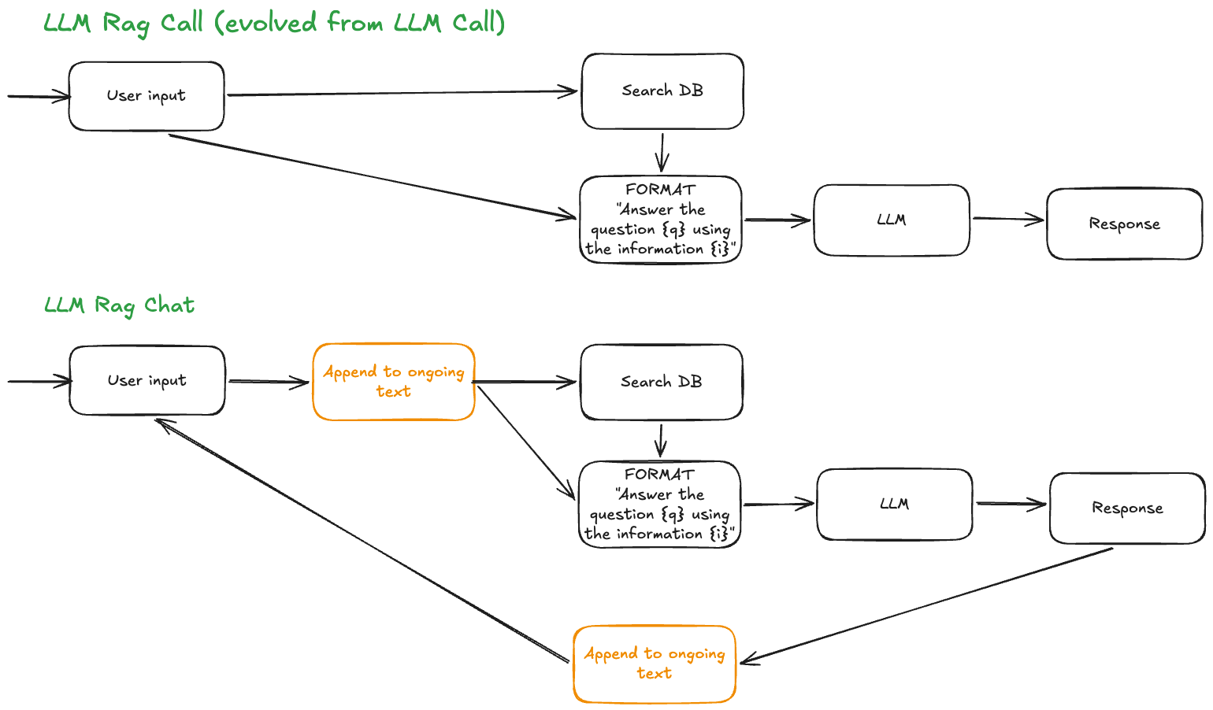

Slide 8
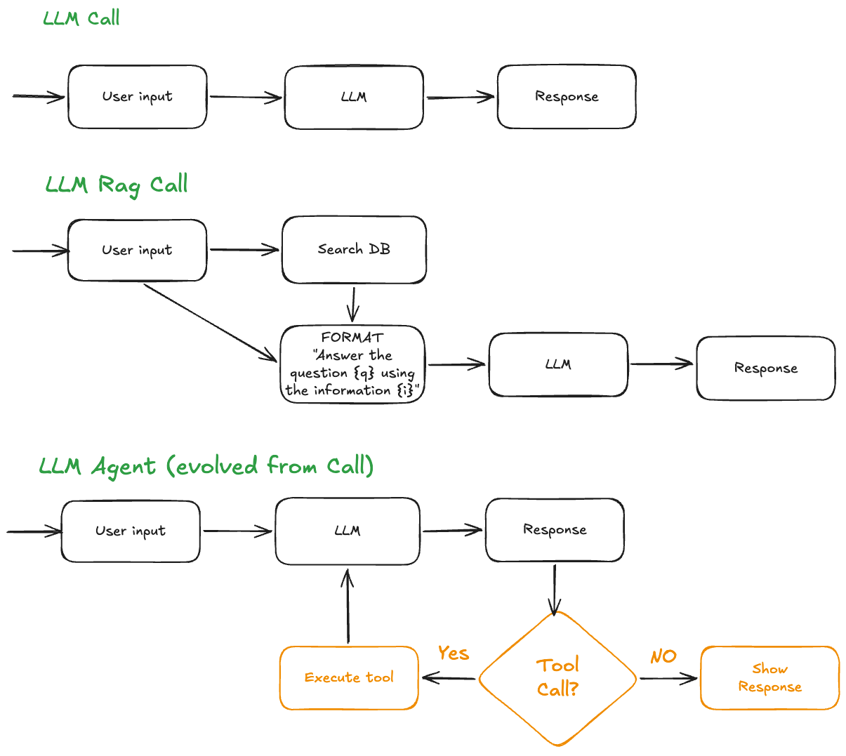

Slide 9


